Slide 1


Basic Details of the Team and Problem Statement
Problem Statement Title: Online Web Portal for Examination
Category Name: 6th to 9th
Team Name: Brainstorm Brigade
Team Leader Name: Ishan Sinha
School Name: Bal Bharati Public School Dwarka

Slide 2

Description of our idea along with prototype
The current examination process is time-consuming and prone to errors, lacking effective tools for performance tracking. The proposed solution is an online web portal that simplifies exam administration, automates grading, tracks student performance over time, and manages student data efficiently.
Key Features:
Teacher Dashboard: Create/manage exams, track performance with analytics, and display results.
Student Dashboard: Take exams, view results, and track progress.
Exam Formats: Objective questions (automatically graded) and subjective questions (manually graded).
Performance Analytics: Graphs and reports showing progress trends and comparisons with class averages.
Notifications: Alerts for upcoming exams and results.
Authentication & Authorization: Secure login system for students, teachers, and admins using role-based access control (RBAC) and Json Web Tokens(JWT) to ensure only authorized users can access certain functionalities.
Link-Enter here
2

Slide 3
Process Flow Chart for students
PDF download of books
Academic
Student
Login
Homepage
Exam schedule for the year
Examination
Results
Signup
Result checking
Examination
Process Flow Chart for Teachers
Upload
Exam paper
Teacher
Login
Homepage
Results

Slide 4
Description of our technology stack
Front end-For the front end of the website we are using HTML, CSS and JS
HTML- HTML stands for HyperText Markup Language. It is being used to give a basic structure and a generic look to webpages. It also helps web browsers display webpages
2. CSS- CSS also known as Cascading Style Sheets is used to make a webpage look pretty and nice. In my web page I have used bootstrap CSS which is one of the best custom CSS available on the internet.
JS- JS stands for Java script. In my webpage it will be used in the backend(Node.js) and it helps me on the main website by preventing users from inputting invalid data for forms and downloading/opening pdfs.
Backend- For the backend of this website I have decided to use Node.js for running a real time java script server and python with Flask, Requests and Web Browser installed as additional packages. This allows for a seamless connection between the server and client with near zero latency on our end.
4

Slide 5
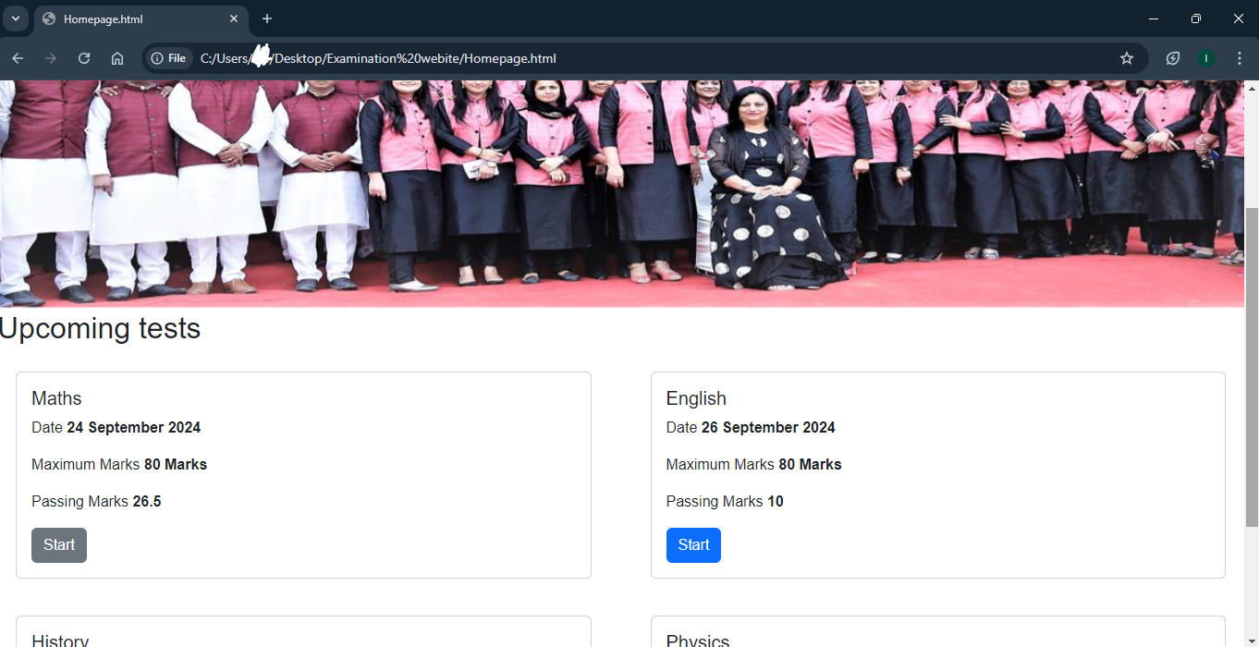
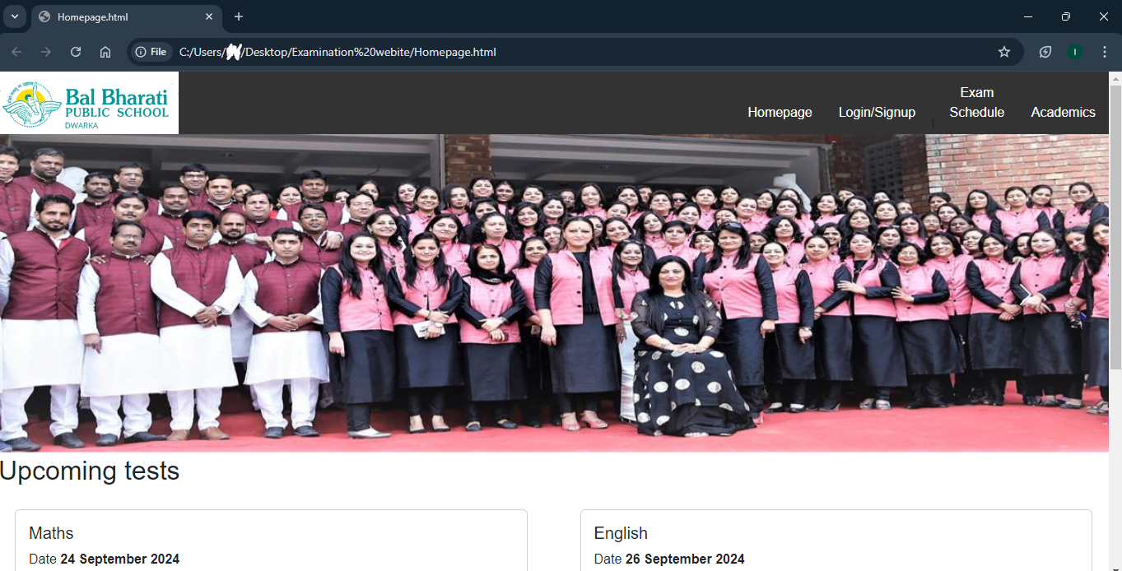
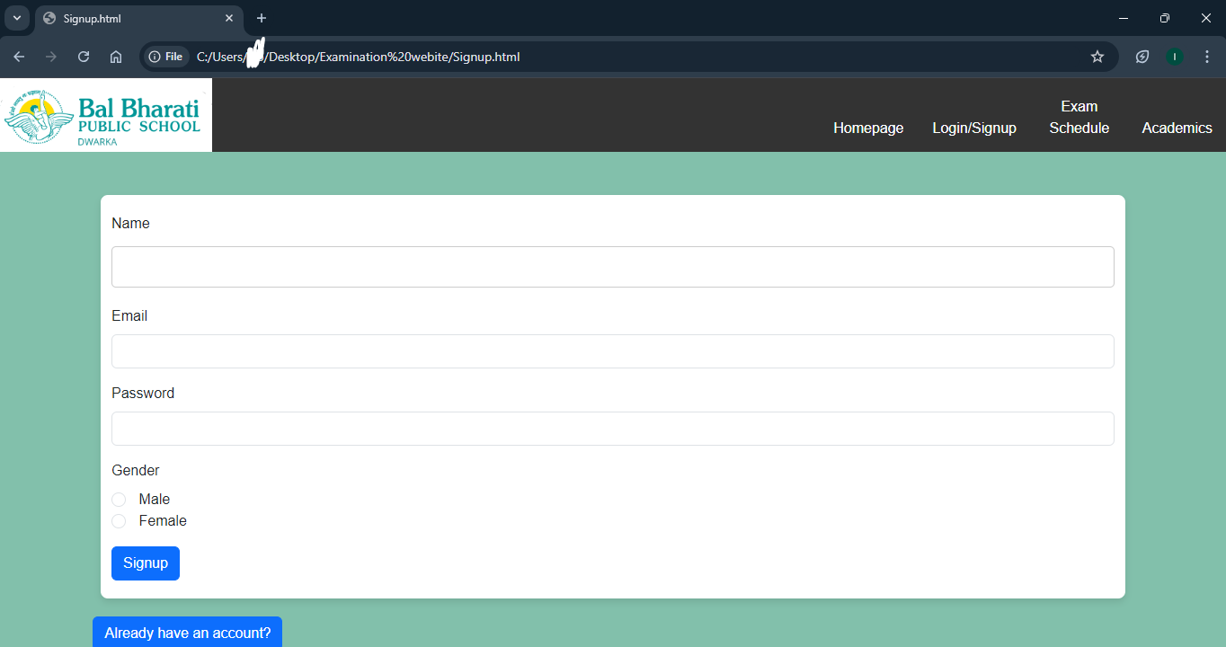
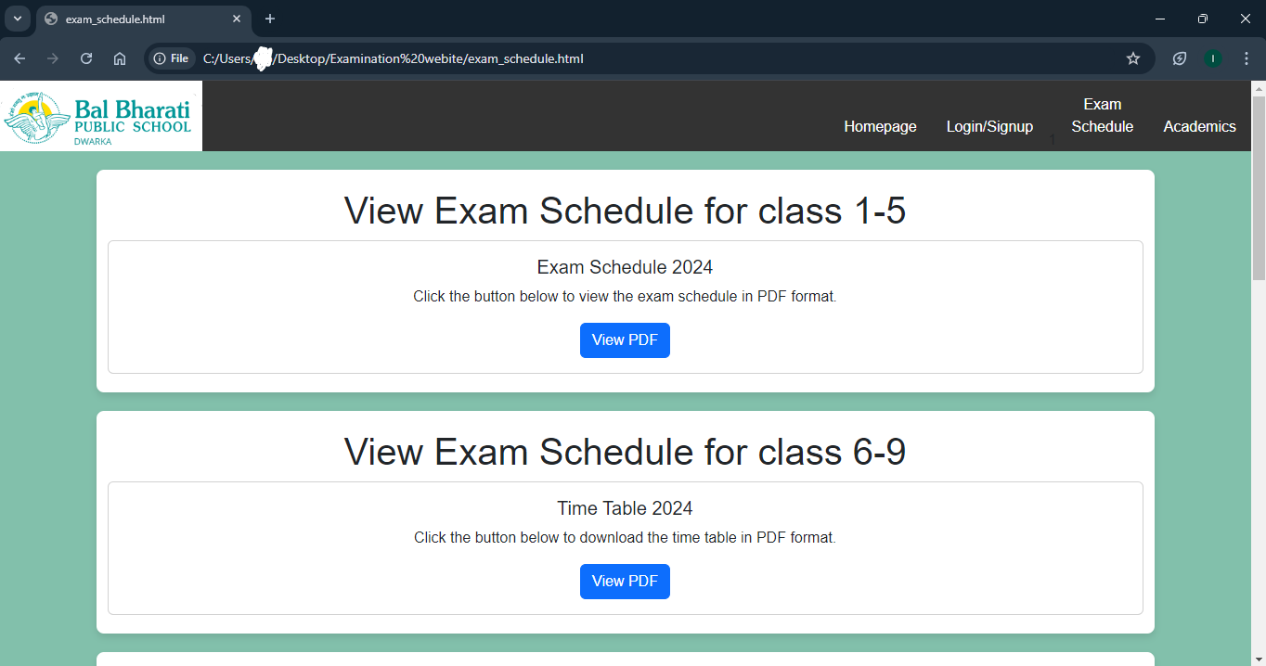
Screenshots
4

Slide 6

Idea/Approach Details
Description of our use cases
1. User Registration
Actors: Student, Teacher
Users register by providing name, email, username, and password.
2. User Login
Actors: Student, Teacher
Users log in with their credentials.
3. Create Exam
Actors: Teacher
Teachers create an exam by entering details.
4. View Exams
Actors: Student
Students view available exams.
5. Take Exam
Actors: Student
Students answer questions and submit the exam.
6. View Results
Actors: Student
Students view their scores and feedback.
7. Provide Feedback
Actors: Teacher
Teachers give feedback on exams.
8.View Submissions
Actors: Teacher
Teachers view student submissions.
9.Update Profile
Actors: Student, Teacher
Users update profile details.
10. Access Study Materials
Actors: Student
Students download study materials.
11.Analytics Dashboard
Actors: Teacher
Teachers view student performance data.
12.Notification Alerts
Actors: Student, Teacher
Users receive notifications for important updates.

Slide 7
Idea/Approach Details
Description of our Dependencies and Show stopper
Financial Dependency -
Development Costs: Building the exam portal needs an initial investment to hire security experts.
Ongoing Maintenance: There are regular costs for updates, fixing bugs, and improving features to keep the portal secure and running well.
Technical Dependency -
Front-End: The portal's user interface uses tools like Bootstrap CSS to ensure it works well on different devices.
Back-End: Technologies like Node.js or Flask handle the data, security, and performance behind the scenes.
Show stopper
AI-Driven Question Generation
AI-Driven Question Generation Uses AI to create new questions based on existing materials, ensuring a fresh and relevant exam experience.
5

Slide 8
Team Member Details
Student’s Details
SL | Student ID | Name | Class | DOB | Email | Phone Number | Gender
1 |  | Ishan Sinha | 9 | 23/02/2011 | ruchitasinha77@gmail.com | 9650011657 | Male
2 |  | Khyati Singh | 9 | 18/03/2011 | Khyatigarima@gmail.com | 8527252659 | Female
3 |  | Yakshit Yadav | 9 | 18/08/2010 | yyp2622@gmail.com | 7048989191 | Male
4 |  | Tejas Tyagi | 9 | 22/6/2010 | tyagitejas777@gmail.com | 8826839531 | Male
5
Mentor Details
SL | Name | UID | Address | DOB | Email | Phone Number | Gender
1 | Prachi Kumari |  | G-120 Gali no. 8 Vishwas Park, Uttam Nagar New Delhi | 12/05/2004 | kprachi.link@gmail.com | 8810687748 | Female

